Slide 1




NEXT GEN EMPLOYABILITY PROGRAM
Creating a future-ready workforce
Team Members
College Name
Student Name: ARUN A
Student ID: au814721104007
SRM TRP ENGINEERING COLLEGE

Slide 2

CAPSTONE PROJECT SHOWCASE
Project Title
Notes Sharing Web Application using Django Framework
Abstract | Problem Statement | Project Overview | Proposed Solution | Technology Used | Modelling & Results | Conclusion

Slide 3
Abstract
Noteflare is a cutting-edge web application designed on the Django framework, aimed at revolutionizing note-sharing experiences.
This platform empowers users to effortlessly create, upload, view, and share notes, fostering seamless collaboration and knowledge exchange.
With robust security measures at its core, including secure user authentication, data encryption, and granular permission controls, Noteflare prioritizes user privacy and data protection. Whether for academic, professional, or personal purposes, Noteflare provides a secure and intuitive space for users to manage their notes and engage in collaborative learning.

Slide 4
Problem Statement
In today's digital age, individuals often struggle to efficiently manage and share their notes in a secure and user-friendly manner. Existing platforms may lack adequate security measures, leading to concerns about data privacy and unauthorized access. Moreover, the absence of seamless collaboration features impedes effective knowledge exchange among users.
Existing note-sharing platforms lack sufficient security measures, raising concerns about data privacy and unauthorized access.
Collaboration features are often limited or absent, hindering effective knowledge exchange among users.
Noteflare addresses these issues by providing a secure, intuitive platform for note creation, sharing, and collaboration, prioritizing both user experience and data protection.

Slide 5
Project Overview
The Noteflare project aims to develop a robust web application built on the Django framework, facilitating efficient note-sharing and collaboration among users. Key features of the platform include secure user authentication, encrypted data storage, and granular permission management to ensure user privacy and data security.
Fragmented Tools: Users often resort to using multiple applications or tools for note-taking, organization, and sharing, resulting in fragmented workflows and inefficiencies.
User Experience Challenges: Navigating between different platforms with varied interfaces and features complicates the note-taking and sharing process, leading to potential information loss or overlook.
Security Concerns: Many existing note-sharing platforms lack robust security measures, leaving user data vulnerable to breaches or unauthorized access. Inadequate encryption and authentication mechanisms further exacerbate privacy concerns, hindering user trust and adoption of such platforms.

Slide 6
Proposed Solution
Unified Note-Sharing Platform: Develop a comprehensive web application like Noteflare that integrates note-taking, organization, and sharing functionalities into a single, cohesive platform. This approach eliminates the need for users to juggle multiple tools, streamlining their workflows and enhancing overall efficiency.
Enhanced User Experience: Prioritize user experience by designing an intuitive and user-friendly interface that simplifies the note-taking and sharing process. Implement features such as seamless navigation, unified search functionality, and customizable organization options to provide users with a smooth and efficient experience.
Robust Security Measures: Implement robust security measures, including end-to-end encryption, secure user authentication, and stringent access controls, to safeguard user data and protect against potential breaches or unauthorized access. By prioritizing data security and privacy, the proposed solution instills confidence in users and encourages widespread adoption of the platform.

Slide 7


Technology Used
Front-end
Back-end

Slide 8
Modelling & Results
Modeling:
Database Structure:
Utilizing Django's ORM, the application's data model is crafted to specify the layout of database tables, ensuring efficient storage and retrieval of information.
Search and Navigation:
An advanced search feature enables users to locate notes effortlessly by employing various parameters such as keywords, titles, categories, or tags, facilitating efficient organization and access.
Outcomes:
The Notes Sharing Web Application, developed on Django, offers users a centralized hub for creating, arranging, and distributing notes with ease. Seamless collaboration functionalities allow users to work together on notes, monitor revisions, and engage in real-time communication with collaborators.

Slide 9
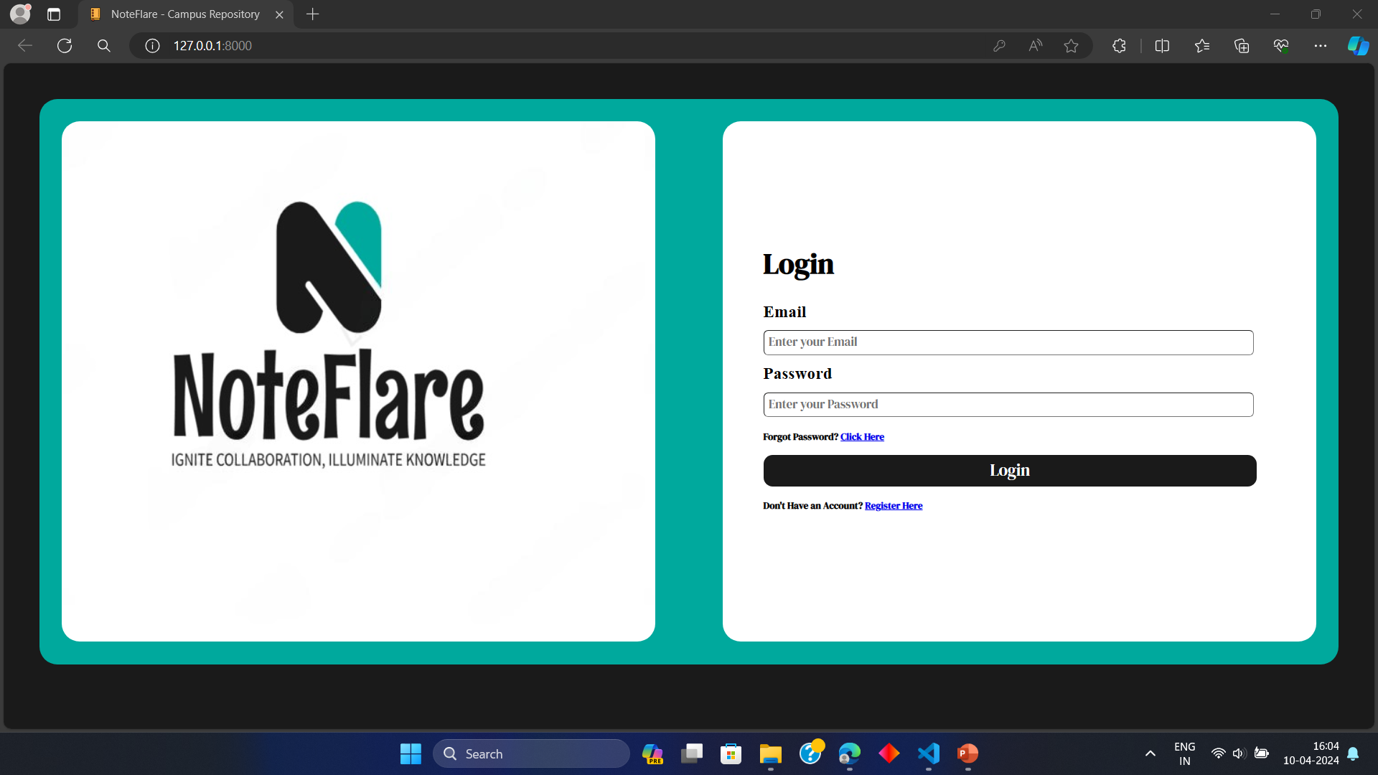
Login page

Slide 10
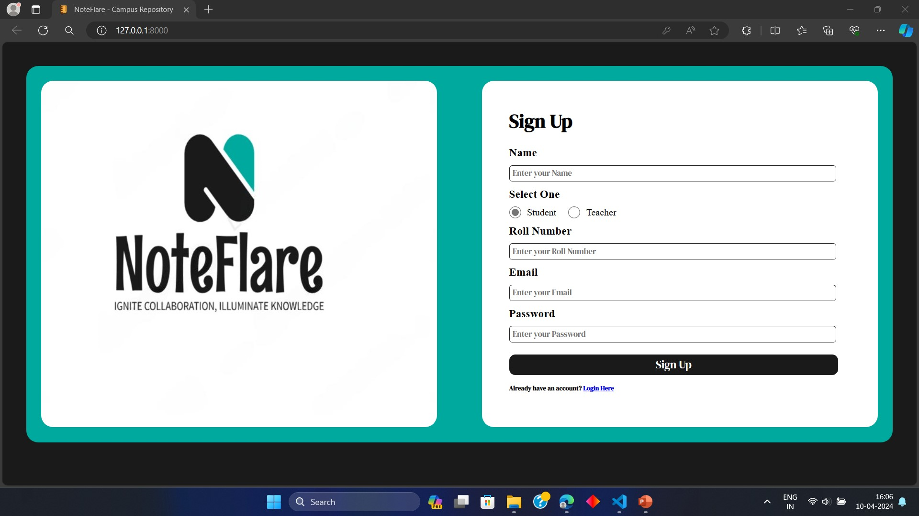
Student’s login

Slide 11
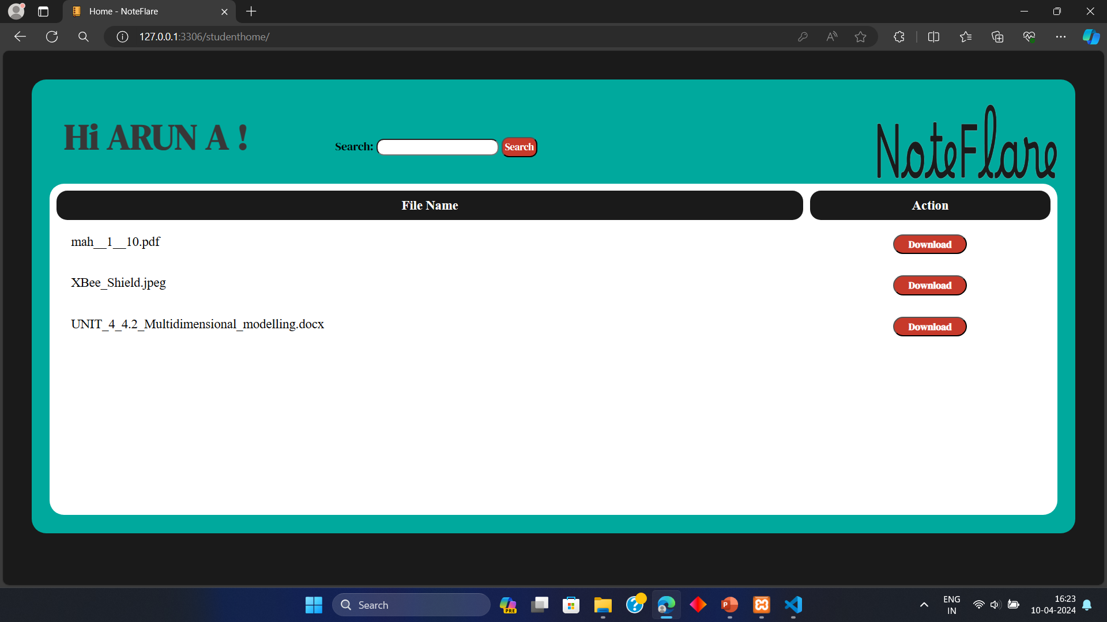
Student’s page

Slide 12
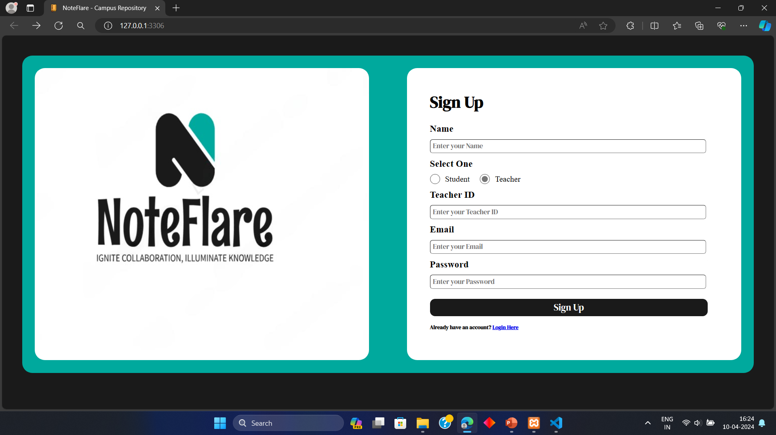
Teacher’s login

Slide 13
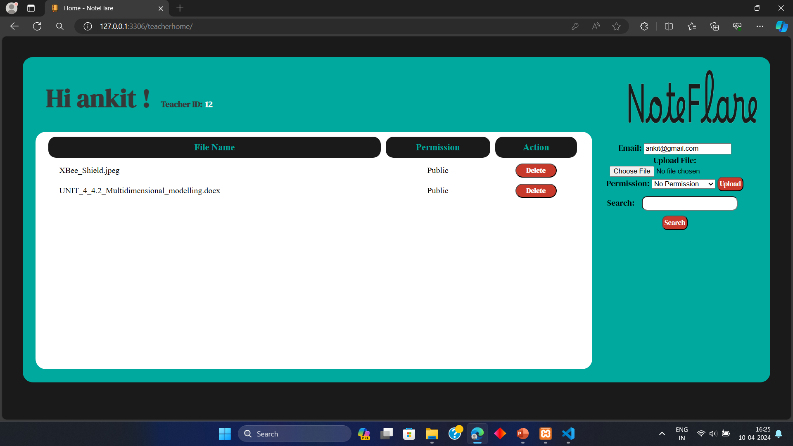
Teacher’s Page

Slide 14
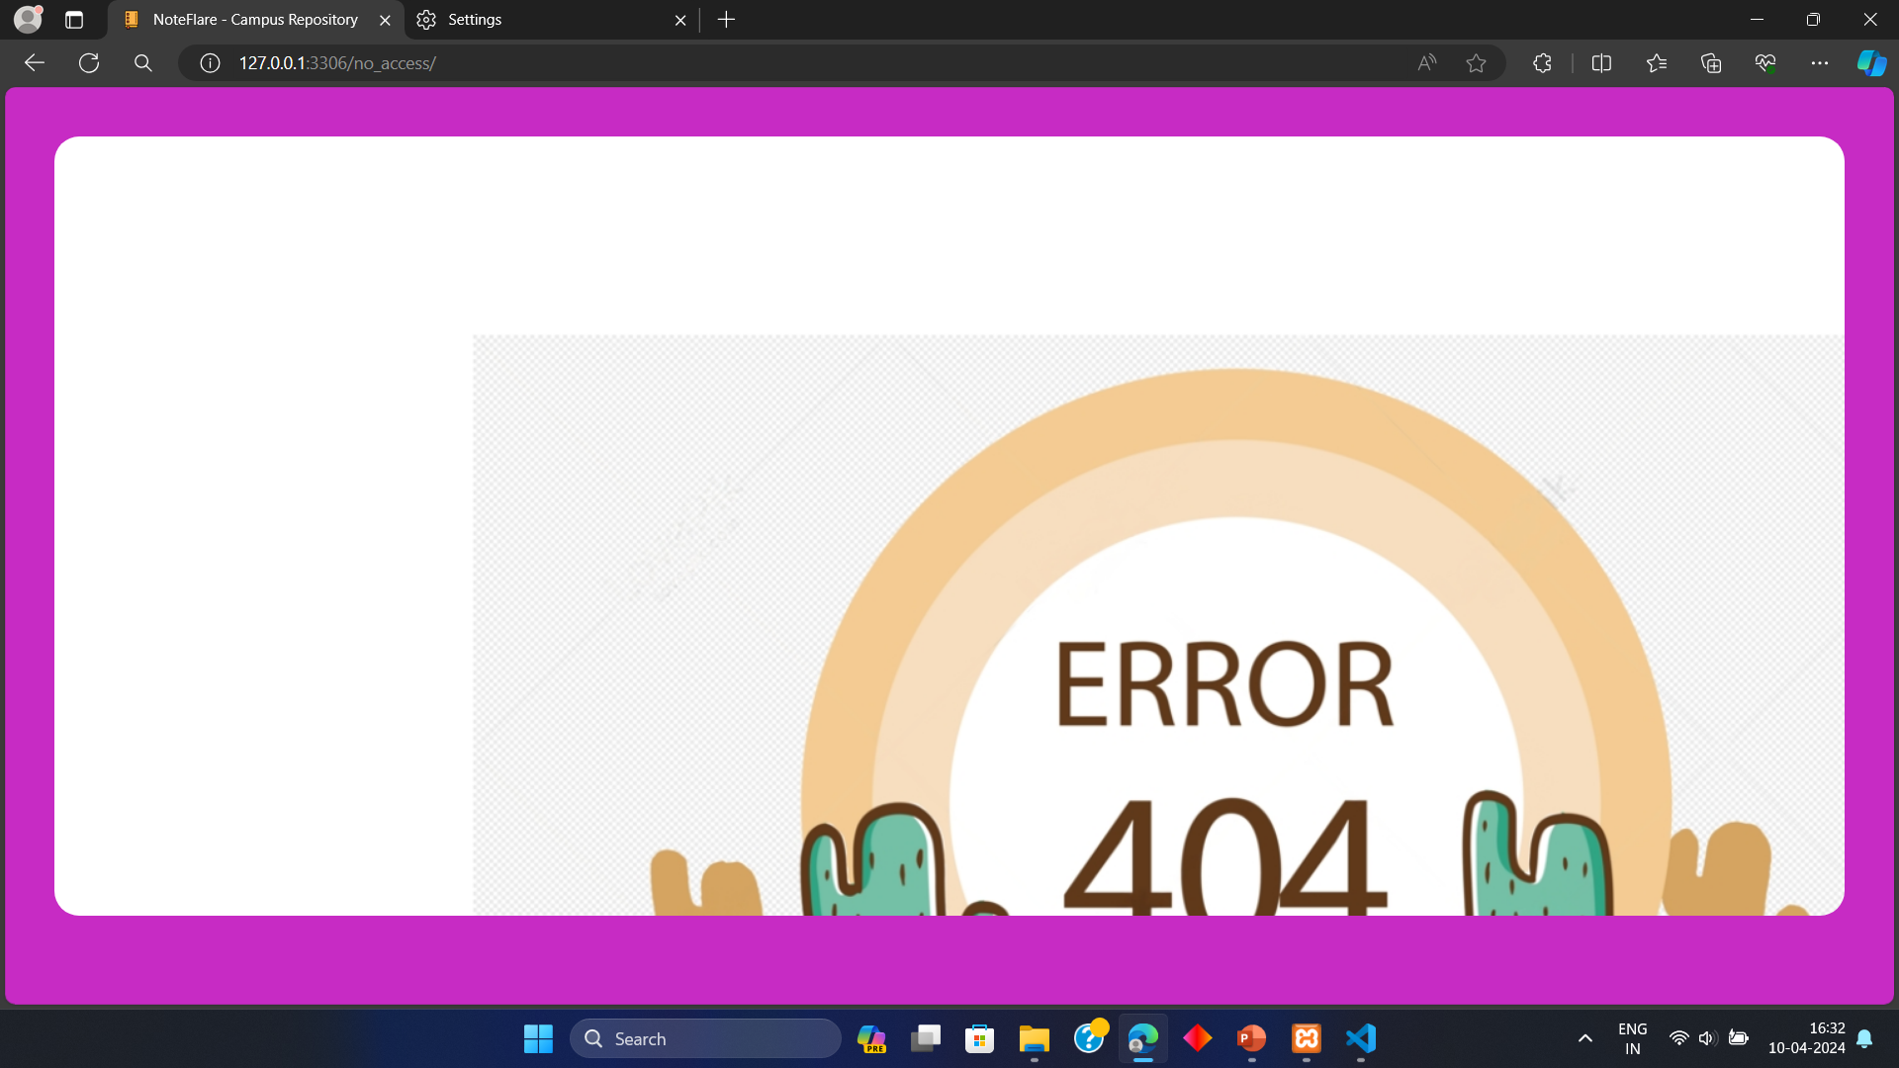
No access

Slide 15
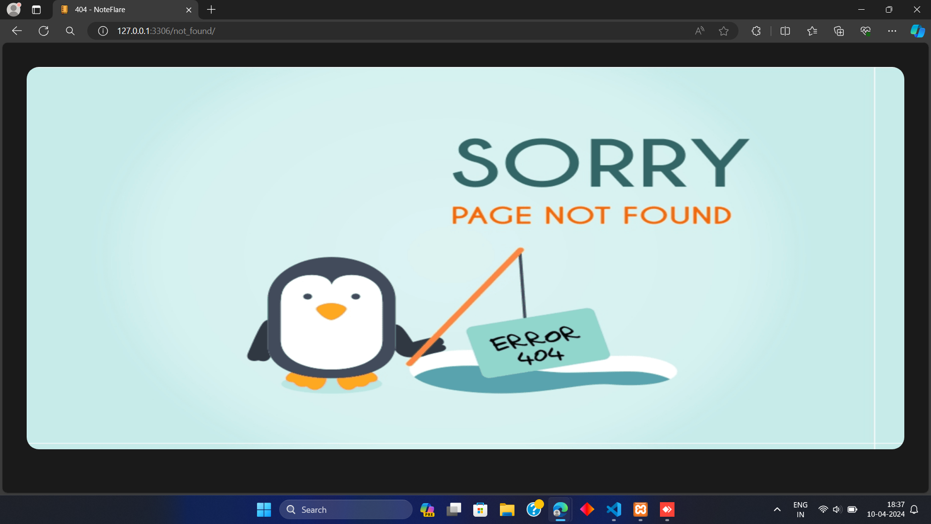
404 error

Slide 16
Future Enhancements
Enhanced Security Measures
Accessibility Features
Community and User Feedback Integration
Mobile Application Support
Offline Access and Synchronization
Customizable Templates and Workflows
Analytics and Insights
Advanced Collaboration Features
Integration with External Tools

Slide 17
Conclusion
The NoteFlare Web Application developed on the Django framework presents a comprehensive solution to the challenges encountered in note-taking, organization, and sharing. By providing a centralized platform with robust security measures, advanced collaboration features, efficient organization tools, and a user-friendly interface, the application aims to streamline workflows, enhance productivity, and facilitate seamless knowledge sharing among users.
Overall, the NoteFlare Web Application serves as a valuable tool for individuals, teams, and organizations seeking to streamline their note-taking processes, collaborate effectively, and harness the power of shared knowledge. Through continuous refinement and innovation, the application will continue to evolve and remain a vital asset for users in their quest for productivity and collaboration excellence.

Slide 18
Thank You!
Notes:
Thank You !!

